Slide 1
Binary Trees
http://blog.hackerrank.com/the-unhealthy-obsession-with-tree-questions/

Slide 2
Interview Questions
http://www.developer.com/mgmt/three-types-of-interview-questions-software-developers-should-expect.html
http://citeseerx.ist.psu.edu/viewdoc/download?doi=10.1.1.471.4772&rep=rep1&type=pdf
http://javarevisited.blogspot.com/2012/01/google-interview-questions-answers-top.html
https://www.careercup.com/page?sort=votes

Slide 3
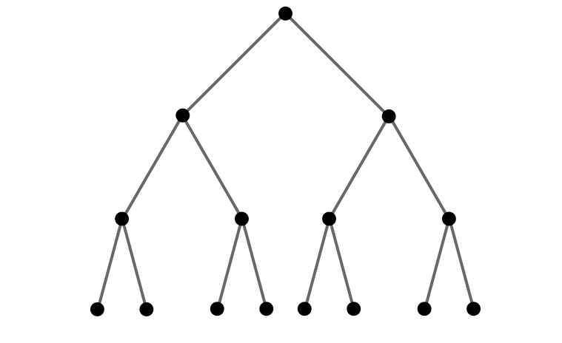
Binary Tree
root
Each node has at most two children, a left child and a right child.
Each node (except the root, perhaps) has a parent.
Often the parent of the root will be itself or null
nodes
height
leaves

Slide 4
Binary SEARCH Tree
PROPERTY OF BST
The left child is less than the node, the right child is greater than the node.
root
Less than the root
More than the root
Least Node
Greatest node

Slide 5
Binary SEARCH Tree
Since the right child is greater than the root, everything in the entire right subtree is greater than the root.
Thinking recursively, since the left child is less than the root, everything in the entire left subtree is less than the root.
Left Subtree
Right Subtree

Slide 6
BST with no nodes.
NULL

Slide 7
BST with one node.
400

Slide 8
Add 200 to the tree
400
200

Slide 9
Add 250 to the tree
400
400
200
250

Slide 10
Add 550 to the tree
400
400
400
200
550
250

Slide 11
A tree (recursively)
BSTNode
Left subtree
Right subtree

Slide 12
BSTNode* that's what I mean by a tree.
root
BSTNode
Left subtree
Right subtree

Slide 13
Insert into a tree, (if it doesn't go here), I call the same procedure on either the left or right subtree
BSTNode
Left subtree
Right subtree

Slide 14
template <class T> void BinarySearchTree<T>::insertHelper(Node<T>* &n, T data) { if (n == NULLNODE) { n = new Node<T>; n->data=data; n->left=NULLNODE; n->right=NULLNODE; return; } /// n is not null, so we can check left & right if (data < n->data) { insertHelper(n->left, data); } else { insertHelper(n->right, data); } }

Slide 15
Look for 250.
1
400
400
400
2
200
550
3
250

Slide 16
Look for 150.
1
400
400
400
2
200
550
not found
250

Slide 17
template <class T> bool BinarySearchTree<T>::findHelper(Node<T>* n, T lookingFor) { if (!n) /// if n is NULLNODE return not found return false; if (n->data < lookingFor) return findHelper(n->right, lookingFor); else if (lookingFor < n->data) return findHelper(n->left, lookingFor); else /// found, return true return true; }

Slide 18
Analysis
Running time for insert and search is proportional to 'height' of the tree.
If I insert nodes in order, like 50, 60 ,70, 80, 90, 100, 110, etc, you get a tall thin tree and the height is O(n)
The best case is when the tree is short and wide, the height is O(lg n)
There are many trees that can contain the same data.
There are many (MANY) schemes to 'height balance' a binary search tree (CSC220) Red Black - AVL - Splay

Slide 19
Two pieces of recursion:
The "recursive" case, the rule that uses a smaller subproblem of itself.
The "base" case, where recursion isn't needed
For insertion
Base case: A node without children, insert it to the left or right depending on < or >. More specifically, if the node is < the the value and the right child is null (and vice versa)

Slide 20
Printing trees (traversal)
A traversal visits every node in the tree.
Pre order traversal
Print the node, then the left, then the right subtrees (recursively)
In order traversal
Print all the values in the tree 'In order" or sorted
Post order traversal
Print the left, then the right subtrees, then the node (recursively)

Slide 21
Traversals
BSTNode
Left subtree
Right subtree

Slide 22
inorder traversal
BASE CASE: If there's no tree, print nothing
Print after the left subtree
BSTNode
Least, print first
Left subtree
Right subtree
Print after the node

Slide 23
template <class T> void BinarySearchTree<T>::inorderHelper(Node<T>* n) { if (n == NULLNODE) return; /// in order traversal of the tree inorderHelper(n->left); std::cout << n->data << " "; inorderHelper(n->right); }

Slide 24
Inorder traversal
inorder(50)
inorder(25) , print 50, inorder(60)
inorder(null), print 25, inorder(45)
inorder(null) returns
25
inorder(30), print 45, inorder(48)
inorder(null), print 30, inorder(null)
30
45
inorder(null), print 48, inorder(null)
48
(and so on)
The print is 'in' between the left and right
50
25
60
45
55
70
30
48
66
86
68

Slide 25
preorder traversal
preorder(50)
50, preorder(25), preorder(60)
25, preorder(null), preorder(45)
45, preorder(30), preorder(48)
30, preorder(null), preorder(null)
48, preorder(null), preorder(null)
60, preorder(55), preorder(70)
and so on
1
The print is 'in' between the left and right
50
2
6
25
60
45
7
8
3
55
70
4
5
9
10
30
48
66
86
11
68

